Slide 1
Capstone Project-4
Online Retail Customer Segmentation
Presented By Nitin Solanki Parth Sharma

Slide 2

STEPS INVOLVED:
Steps that significantly contribute towards
achieving the final results are listed below:
Defining The Problem Statement.
Applying The Data Pre-Processing Steps.
Exploratory Data Analysis.
Feature Engineering.
RFM Model.
Model Building.
Model Implementation.

Slide 3

CUSTOMER SEGMENTATION:
WHAT:
Customer segmentation is the practice of dividing a company’s customers into groups that reflect similarity among customers in each group.
WHY:
The goal of segmenting customers is to decide how to relate to customers in each segment in order to maximize the value of each customer to the business.

Slide 4
DATA PIPELINE:
Data Processing-1: In this stage, we went on to some Initial review on the dataset in order to learn get an insight of the dataset.
Data Processing-2: During this phase, data cleaning was the agenda so we looked for the outliers, duplicate values in the data.
EDA: EDA or Exploratory Data Analysis is the critical process of performing the initial investigation on the data. So, through this we have observed certain trends and dependencies and also drawn certain conclusions from the dataset that will be useful for further processing.
RFM Model (Recency, Frequency,Monetary ): Here, we have transformed our features in terms of Recency, Frequency, Monetary depending on these factors we segmented our customers.
Model Fitting : The transformed data is we pass it to different clustering models to get optimum number of segments.

Slide 5
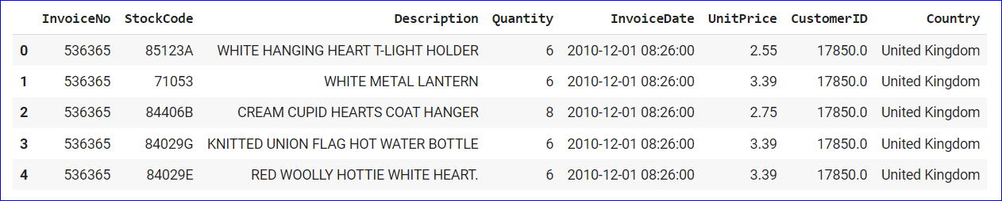
ABOUT THE DATASET
InvoiceNo: Invoice number. Nominal, a 6-digit integral number uniquely assigned to each transaction. If this code starts with letter 'c', it indicates a cancellation.
StockCode: Product (item) code. Nominal, a 5-digit integral number uniquely assigned to each distinct product.
Description: Product (item) name. Nominal.
Quantity: The quantities of each product (item) per transaction. Numeric.
InvoiceDate: Invoice Date and time. Numeric, the day and time when each transaction was generated.
UnitPrice: Unit price. Numeric, Product price per unit in sterling.
CustomerID: Customer number. Nominal, a 5-digit integral number uniquely assigned to each customer.
Country: Country name. Nominal, the name of the country where each customer resides.

Slide 6

Let’s Start EDA

Slide 7
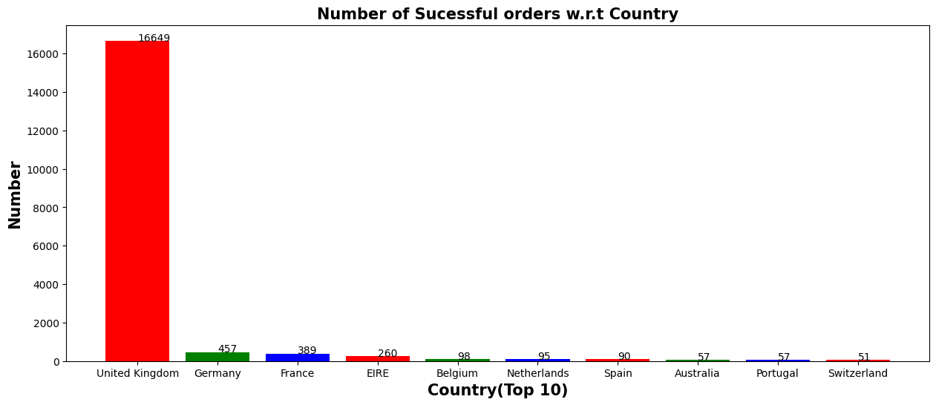
Top 10 Countries w.r.t number of successful order generated
Highest number of the order placed from the country United kingdom and the lowest from Switzerland(in the top 10 list).

Slide 8
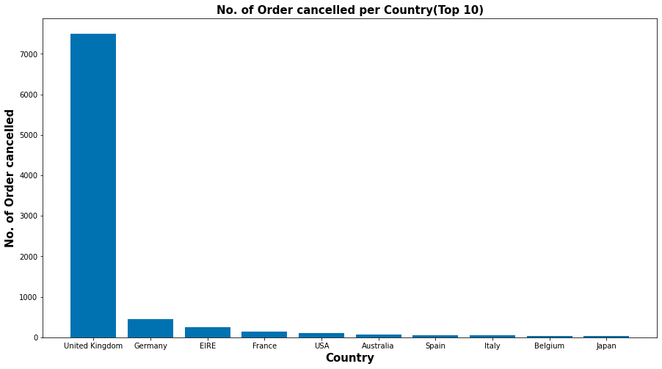
Top 10 Countries w.r.t number of order cancelled
Highest number of the order Cancelled from the country United kingdom and the lowest from Japan(in the top 10 list)

Slide 9
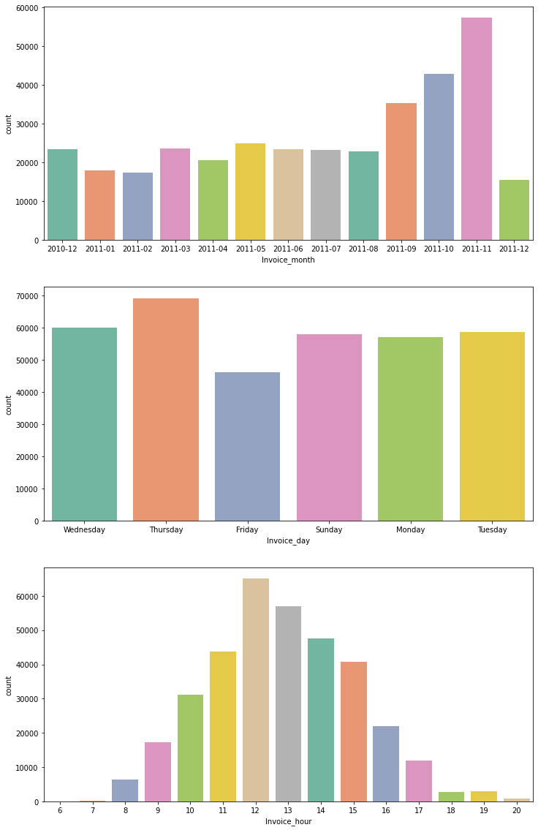
Month wise order analysis
Maximum amount of invoices were generated in the month of November in 2011 that crosses almost 6000 numbers and the least number of orders are placed in month of December

Slide 10
Day wise order analysis
From the chart we conclude that Thursday can be regarded as the most rushed day in the whole week.

Slide 11
Hour wise order analysis
Maximum rush was observed in the mid-day i.e. between 12 hrs to 14 hrs.

Slide 12
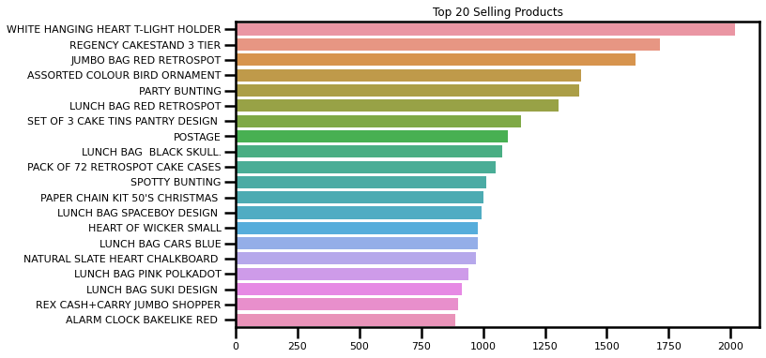
Top 20 Products w.r.t Quantity
White Hanging Heart T-light holder is the top selling item followed by Regency Cakestand 3 Tier.

Slide 13
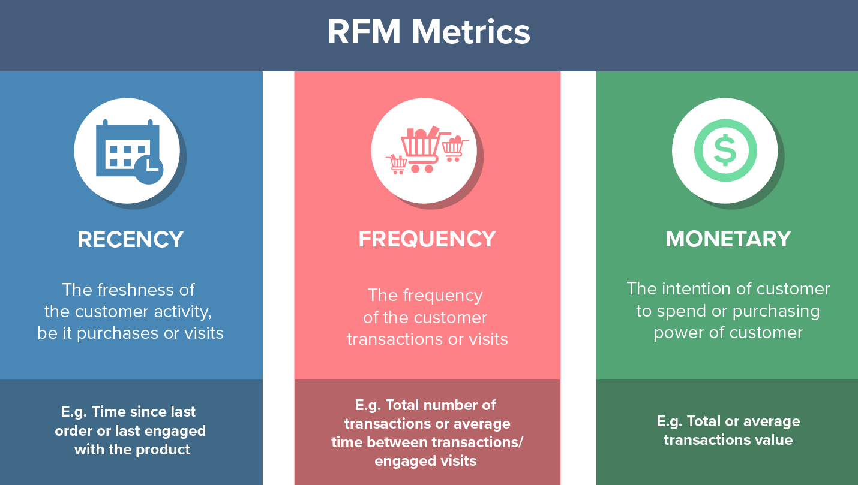

Slide 14
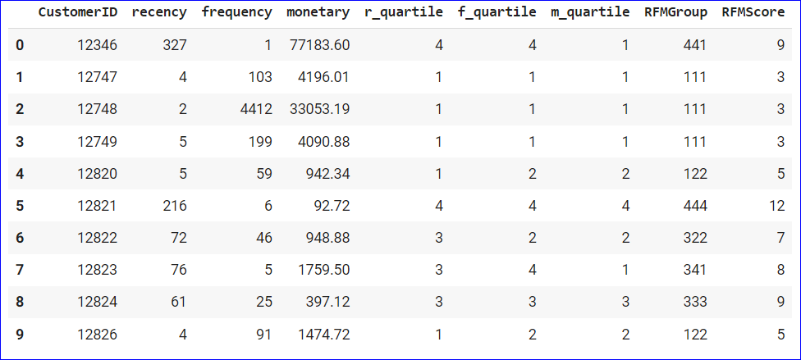
RMF Table
Best Customer with RFM Score :111 : who have bought the most recent, the most often, and with high revenue.
Big Spenders with RFM Score: XX1 : who have generated the most revenue
Loyal customers with RFM Score: X1X customers who arrive the most at the store to shop

Slide 15
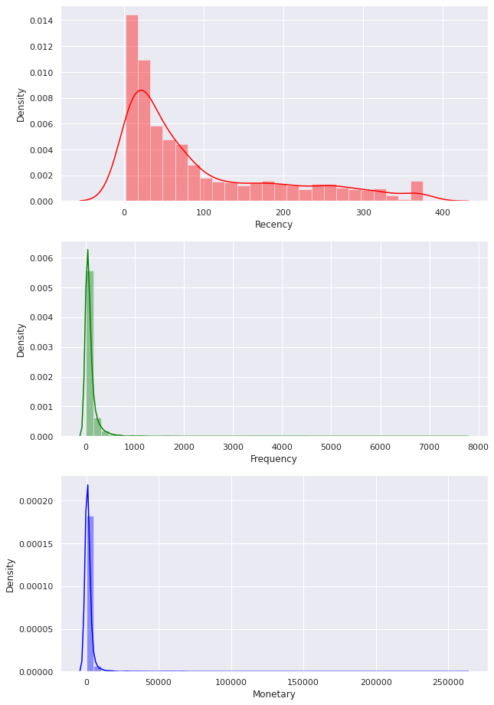
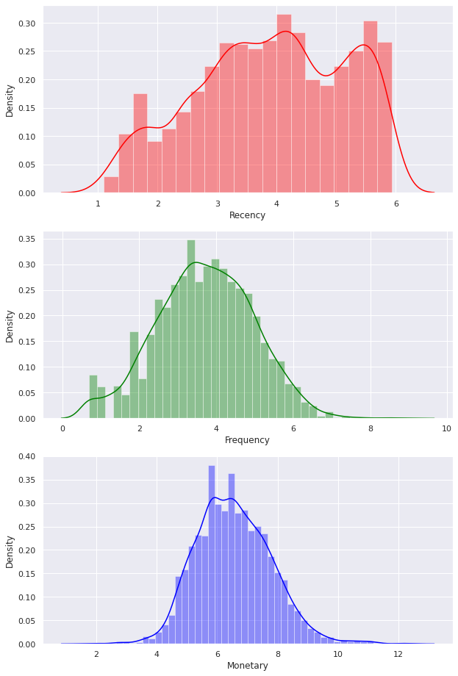
Recency
Before Normalization
After Log Transformation

Slide 16
Frequency
Before Normalization
After Log Transformation

Slide 17
Monetary
Before Normalization
After Log Transformation

Slide 18
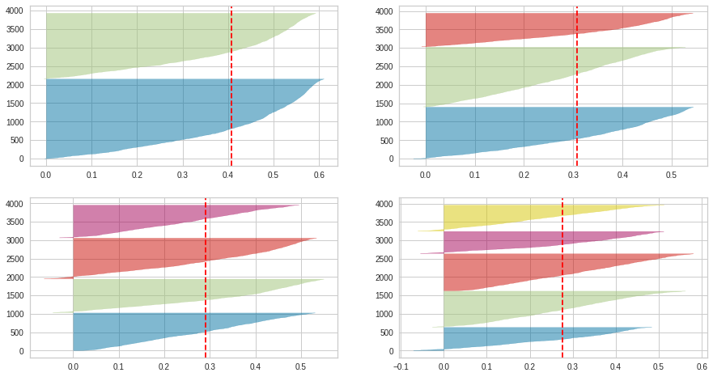
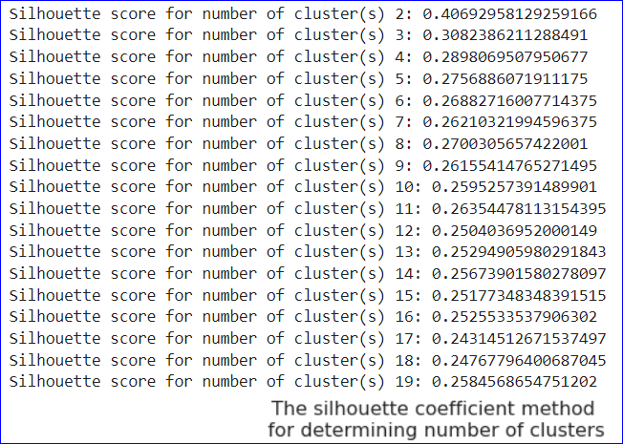
Silhouette Score For K-Means Clustering
Silhoutte Analysis suggests that the optimum number of cluster for our analysis could be 2.

Slide 19
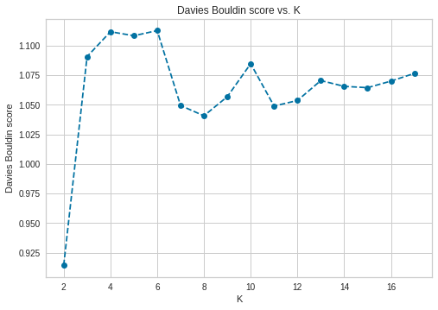
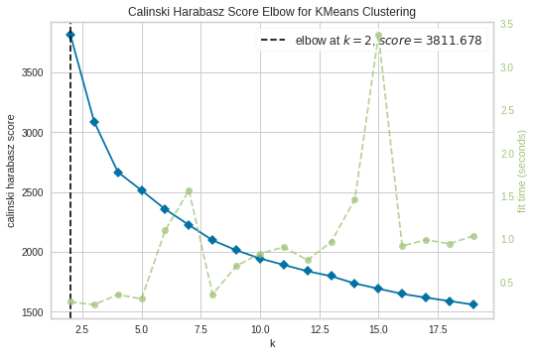
DB Score and CH Index For K-Means Clustering
We can say that optimum number of cluster suggested according to the DB-Index and Calinski-Harabasz Index are 2

Slide 20
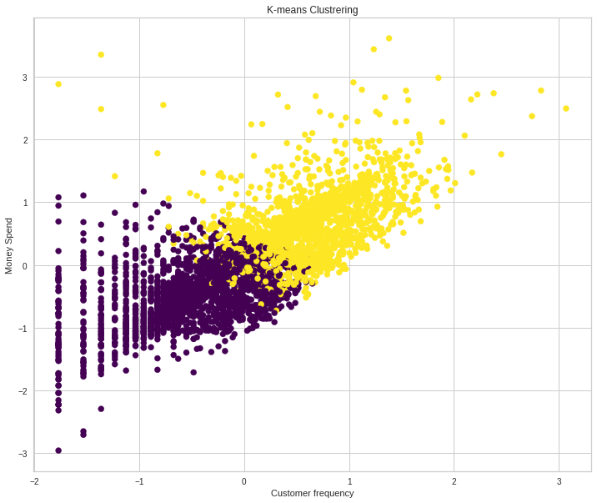
K-Means Cluster Chart

Slide 21
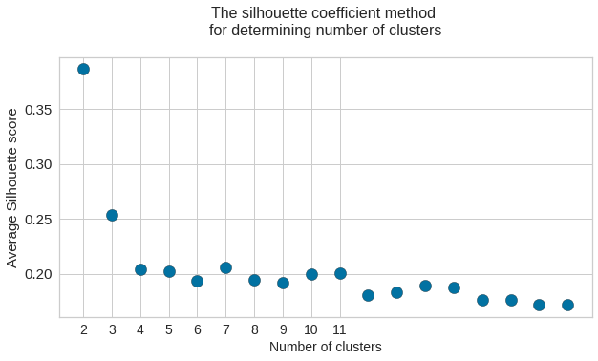
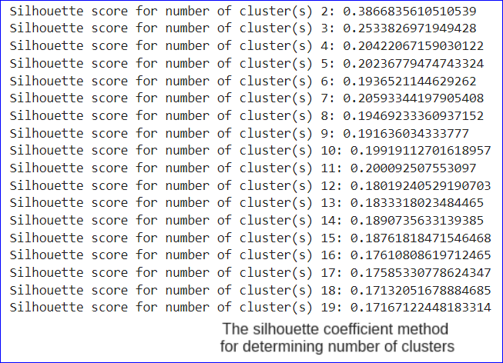
Silhouette Score For Hierarchical Clustering
Silhoutte Analysis suggests that the optimum number of cluster for our analysis could be 2.

Slide 22
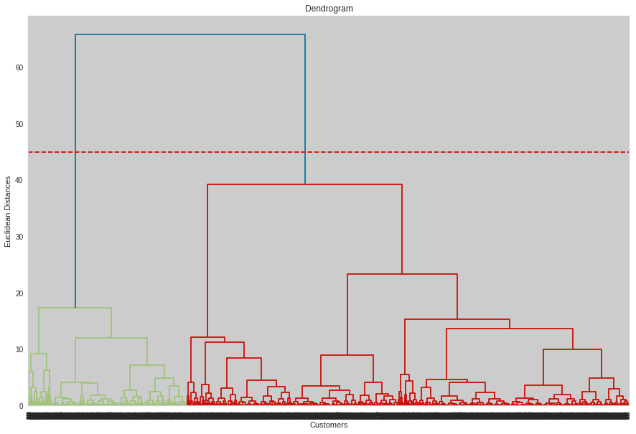
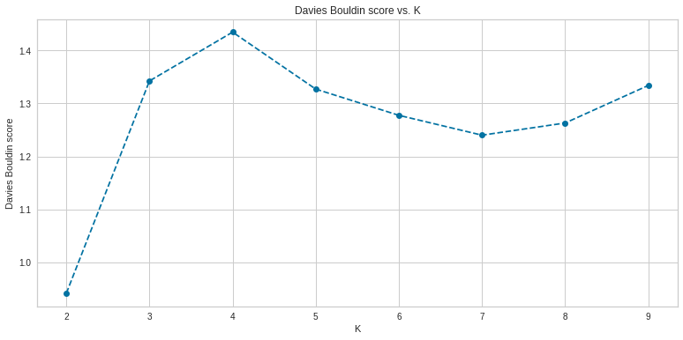
Dendogram and DB Score Hierarchical Clustering
We can say that optimum number of cluster suggested according to the DB-Index and Dendogram are 2

Slide 23
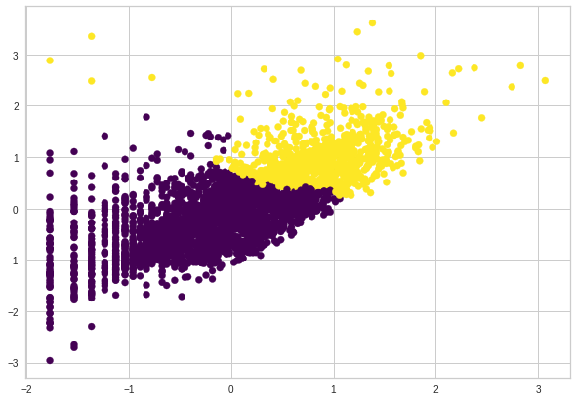
Hierarchical Cluster Chart

Slide 24
CONCLUSIONS:
Built a clustering model using K-means and hierarchical clustering to identify major customer segments on transaction data to optimize the impact of marketing.
Engineered features to obtain new features such as RFM, and RFM-Score for getting more details about the customers' purchasing behavior.
Evaluated the optimal clusters using the silhouette score, CH index and dendrograms. The optimal number of clusters was 2 with a silhouette score of 0.4.
Model Name | Optimal Number of Cluster
K-Means with Silhouette Score | 2
K-Means with CH Index | 2
K-Means with DBSCAN | 2
Hierarchical Clustering with Silhouette Score | 2
Hierarchical Clustering with Dendogram | 2
Hierarchical Clustering with DBSCAN | 2

Slide 25
Thank You

